Slide 1
Smart India Hackathon 2022 Stage 1 Internal Selection
Organization: Ministry of Micro, Small and Medium Enterprises (MSME)
Problem Statement: RK1129 - App-Based solution to identify and solve disease in plants/crops.
Team: Made4Innovation
Team Leader: Mr Ashish Kotecha
Team Leader email: kotecha_ashish.ai@ghrce.raisoni.net

Slide 2
Problems
Lack of awareness in farmers about plant diseases
leading to crop failure
Unavailability of platforms which connects farmers with Agrologists
Lack of instant
proper treatment
Lack of remedies for
certain plant diseases
Crop failure have disastrous consequences for
smallholder farmers

Slide 3
Solutions
Features
A smart application that
identifies the plant disease instantaneously
Availability of our own agroexpert bot
The application connects farmers with Agrologists with respect to crop disease
Diagnose and Treat Crop Issues
Get Your Questions Answered By Experts
The app has the ability to identify diverse crop defects
Get personalised recommendations based on weather conditions

Slide 4
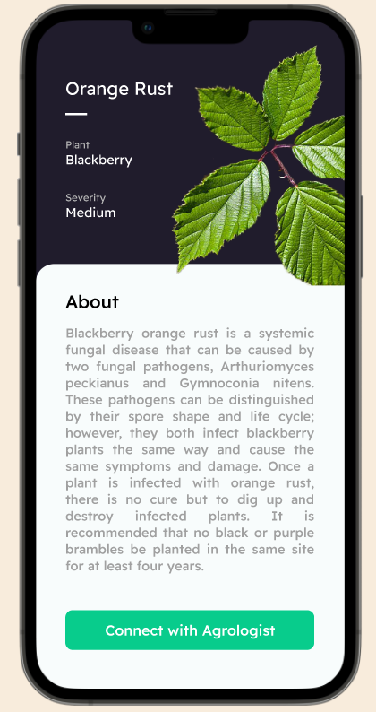
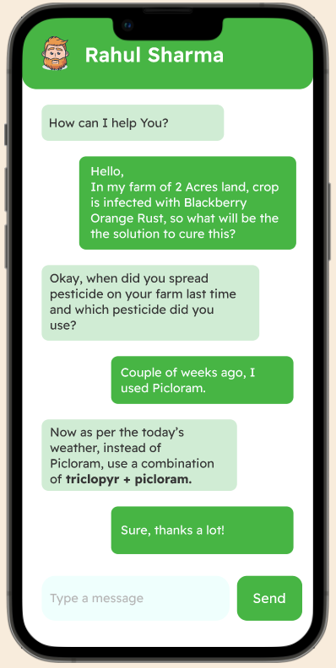
Prototype
Click
Connect
Cure

Slide 5
Tech Stack
Future Scope
Tensorflow
Keras
Ionic + Capacitor
React
Socket.io
nodeJS
Reinforcement learning
AI approach
Meeting Scheduling and Calling system
Subscription based revenue model

Slide 6
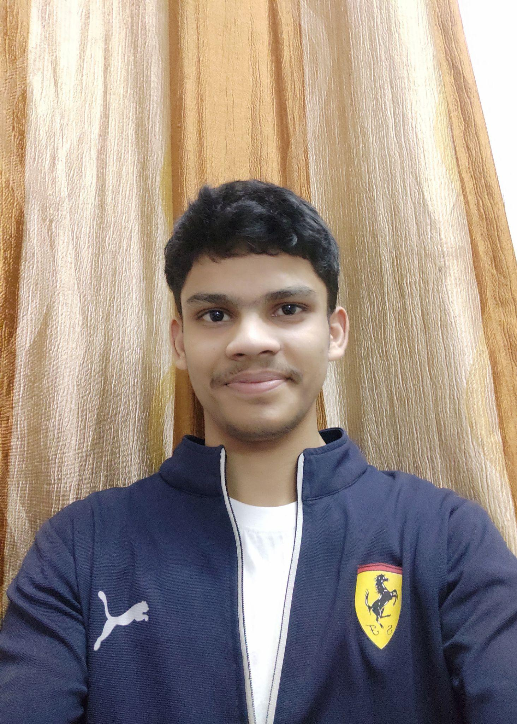
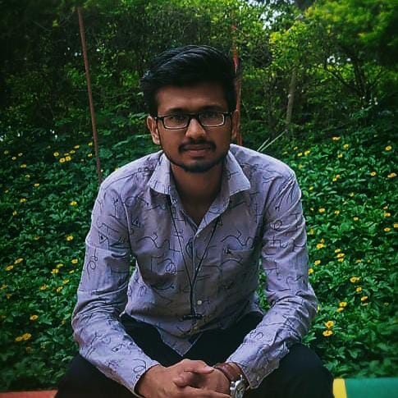
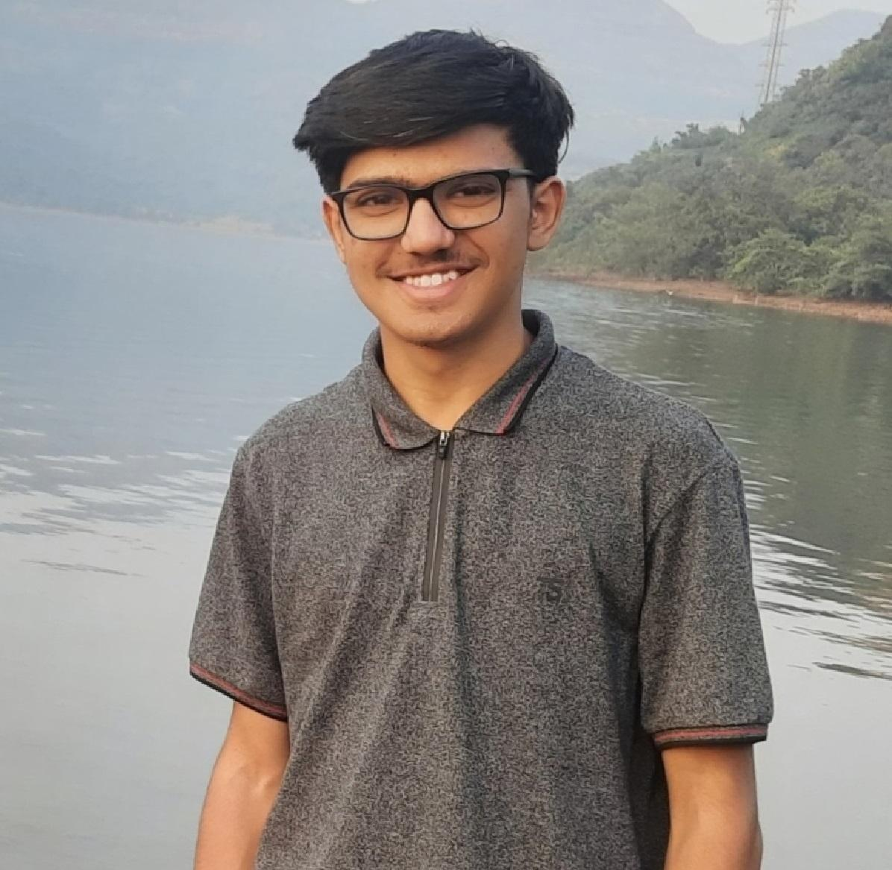
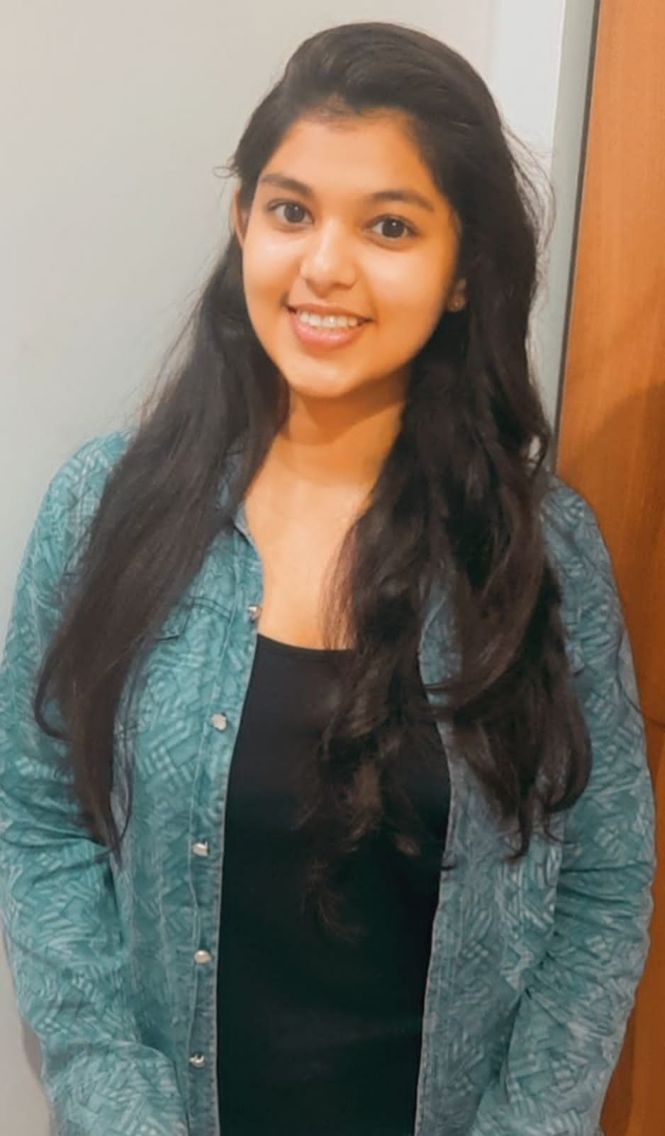
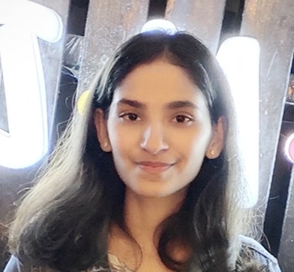
Team Details
Ashish Kotecha
VI Sem AI
Gaurav Patil
VI Sem AI
Atharva Deolalikar
VI Sem AI
kotecha_ashish.ai@ghrce.raisoni.net
patili_gaurav.ai@ghrce.raisoni.net
deolalikar_atharva.ai@ghrce.raisoni.net
…
Charvi Chandekar
IV Sem AI
Hrugved Kolhe
VI Sem AI
Khushboo Agnihotri
VI Sem CSE
charvi.chandekar.ai@ghrce.raisoni.net
kolhe_hrugved.ai@ghrce.raisoni.net
agnihotri_khushboo.cs@ghrce.raisoni.net

